Slide 1

UC workgroup: Finding data sources
09/10/2020

Slide 2
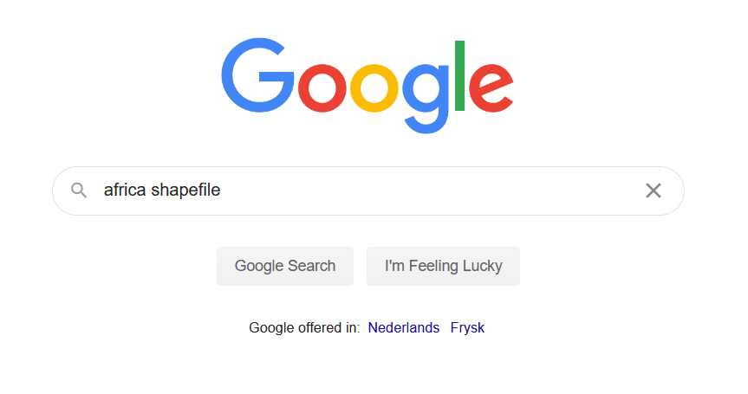

Slide 3
Regular Google search
Problems
Cannot find dataset which contains exactly the specific data I need (in this case: specific countries)
Dataset is in wrong file format
Cannot find dataset at all

Slide 4
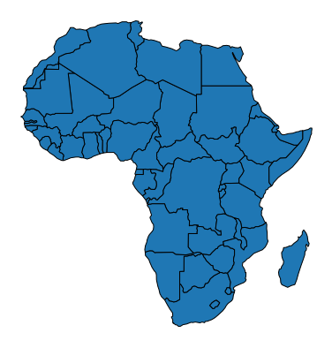
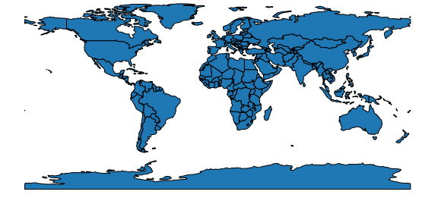
Choose a broader dataset
Filter unnecessary data*
*basic preprocessing in pandas

Slide 5
Merge multiple smaller datasets
Merge*
*merging in pandas

Slide 6
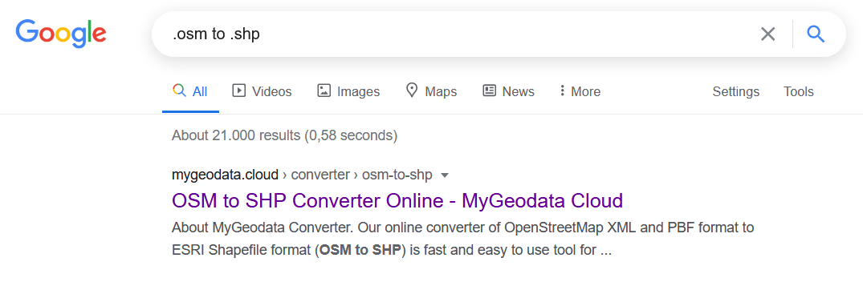
Look for tools to convert filetype

Slide 7
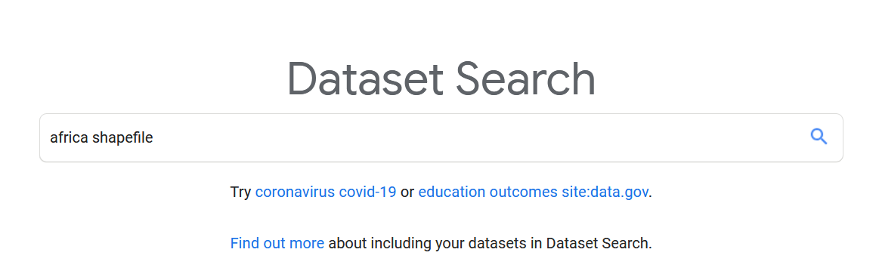
Try different search engine
https://datasetsearch.research.google.com/

Slide 8
Other options
Find a tool to generate your own dataset
Or to export a subset of an existing dataset
Create your own tool, for example to scrape data from a webpage
Or to create synthetic data (A1)
Look at related scientific work, they should cite their dataset sources

